Slide 1
Overview and Introduction to Alma Analytics
Yoel Kortick – Senior Librarian

Slide 2
Introduction
In this presentation we will cover the following topics:
Oracle Analytics Server
ETL
Default and customized reports
Dashboards
Folders
Sharing
Types of reports
Exporting reports
Subject areas
Role bases activities

Slide 3
What is Alma Analytics? - Oracle Analytics Server
Alma Analytics is built on the Oracle Analytics Server
The Oracle Analytics Server also includes Data Visualization (typically referred to as “DV”)

Slide 4
What is Alma Analytics? - ETL
An incremental ETL (Extract, Transform and Load) occurs every night.
This ensures that the data in Alma Analytics is always up to date and identical with data in Alma.
The vast majority of subject areas are updated daily.
The “Titles” subject area and the “Benchmark Analytics” subject areas are updated less frequently.

Slide 5
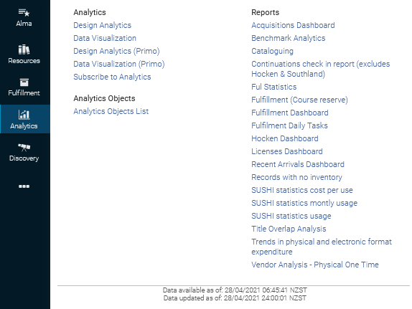
What is Alma Analytics? - ETL
A full ETL began at midnight and was completed well before the start of the work day

Slide 6
What is Alma Analytics? – Default and customized reports
Alma Analytics enables the institution to run reports on library activities.
The reports may be
  Out-of‐the‐box reports that are provided by Ex Libris
  Customized reports created by the institution

Slide 7
What is Alma Analytics? – Dashboards
Groups of reports can be displayed in dashboards that each institution may customize.
Alma comes ready with several “out of the box” dashboards

Slide 8
What is Alma Analytics? – Dashboards
These are the dashboards and reports available to the currently logged in user. Each user can access different dashboards based on his roles.

Slide 9
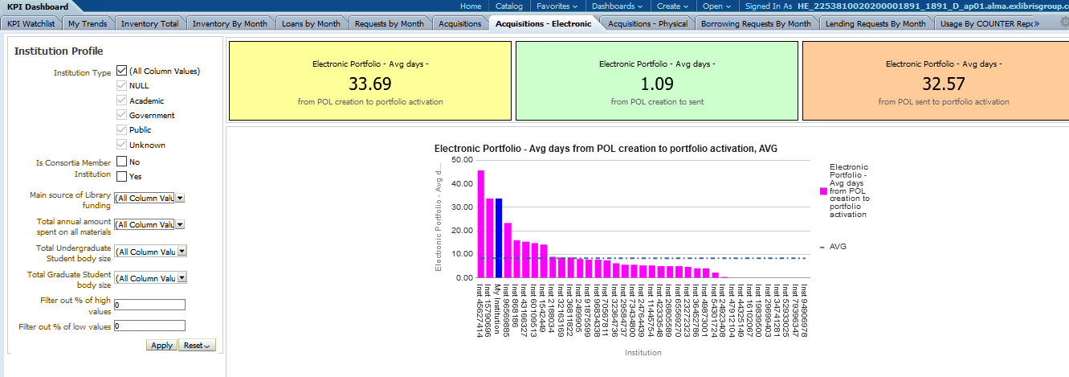
What is Alma Analytics? – Dashboards
This is an example of the Benchmark Analytics Dashboard

Slide 10
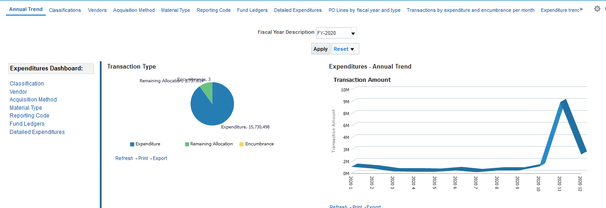
What is Alma Analytics? – Dashboards
This is an example of the Acquisitions Analytics Dashboard

Slide 11
What is Alma Analytics? – Folders and Sharing
Reports and dashboards that the institution creates may be shared with other Alma users in institutions throughout the world.

Slide 12
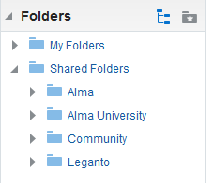
What is Alma Analytics? – Folders and Sharing
My Folders: A read / write personal folder accessible only to the logged in user
Alma: A read-only folder containing Ex Libris OOB reports
Institution Name: A read / write folder of the institution to save and edit reports. Accessible and visible only to the institution. At each institution it is the name of the specific institution
Community: A read / write folder visible and accessible to save and copy for all institutions. Includes reports and dashboards for all institutions in the world. Contains only queries (no data of other institutions is visible)

Slide 13
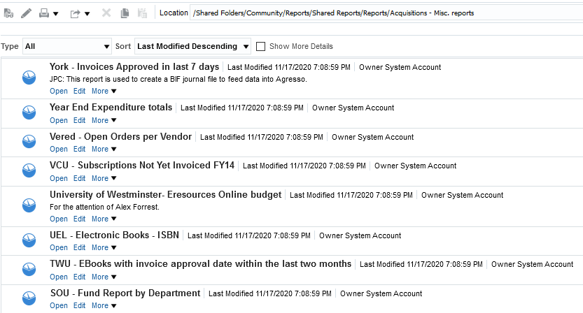
What is Alma Analytics? – Folders and Sharing
Shared acquisitions reports from around the world
Report names start with the code of contributing institution

Slide 14
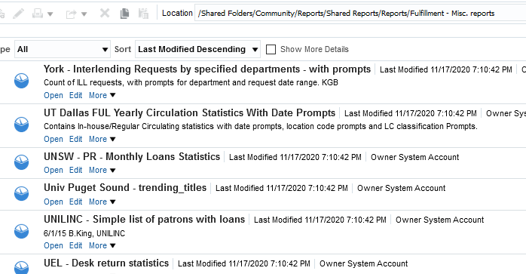
What is Alma Analytics? – Folders and Sharing
Shared acquisitions reports from around the world
Report names start with the code of contributing institution

Slide 15
What is Alma Analytics? – Types of reports
Alma analytics is not merely a “reporting tool”
The reports in Alma Analytics are both
Operational
  Show what has happened and is happening in the library
Predictive
  Show what will happen in the library based on previous data
  This allows the library to perform data-driven decision making
  The library can make informed decisions on how to run the library

Slide 16
What is Alma Analytics? – Types of reports
Operational
  Regular day to day activities - what's going on in your library
  Can be done in Analytics
  Includes also reports already in Alma
    Fulfillment > Advanced Tools > Fines and Fees reports
    Retrieve users and filter then export to Excel
    Monitor Hold Requests > facet > Export to Excel
    Active Hold shelf > Export to Excel
    Search > facet > Export to Excel
Business
  Data driven decision making
  “Business” like the “B” in OBI
  Provides information to the decision makers
      Where should money most effectively be spent
      Where should staff most effectively be distributed

Slide 17
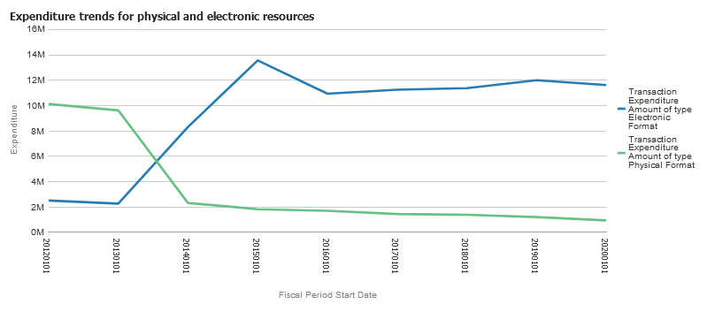
What is Alma Analytics? – Types of reports
Here we identify an obvious trend of physical item purchasing decreasing each year and electronic purchasing increasing. We can prepare budgets and space on the shelves accordingly.

Slide 18
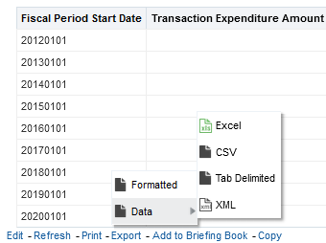
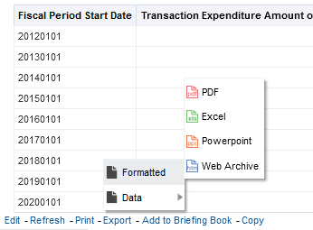
What is Alma Analytics? – exporting reports
Reports can be exported in a variety of formats

Slide 19
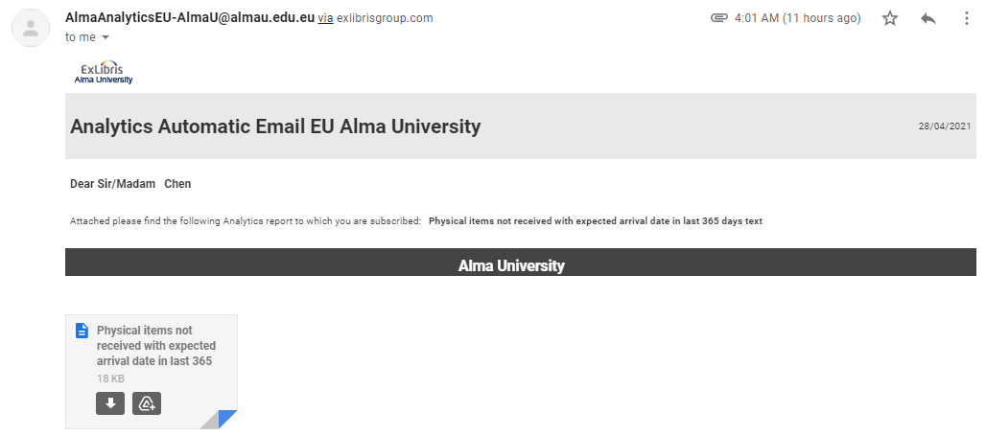
What is Alma Analytics? – exporting reports
Reports can be sent by email as scheduled reports in a variety of formats

Slide 20
What is Alma Analytics? – subject areas
Alma Analytics includes a wide variety of subject areas.
When a report is made the user chooses a specific subject area on which on base his report.
Subject areas may also be combined
  By adding an additional subject area which has a common dimension
  By filtering on a separate report made in a different subject area

Slide 21
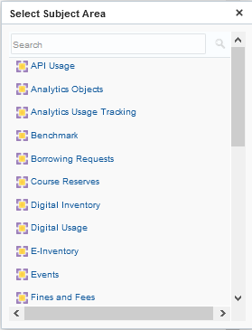
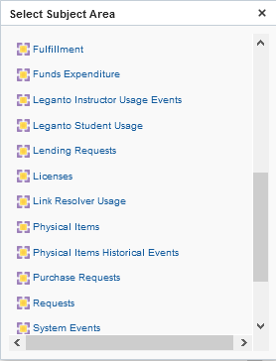
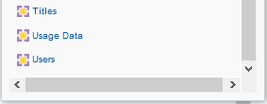
What is Alma Analytics? – Current subject areas

Slide 22
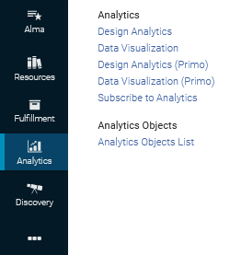
What is Alma Analytics? – role based
Alma Analytics may be accessed by staff users depending on roles
‘Design Analytics’ allows the user to create and edit existing reports
‘Analytics Objects List’ allows the user to take existing reports and make them into widgets, scheduled reports, and accessible via the dashboard
‘Subscribe to Analytics’ allows the user to subscribe to schedules reports which he can receive via email on a daily, weekly or monthly basis

Slide 23
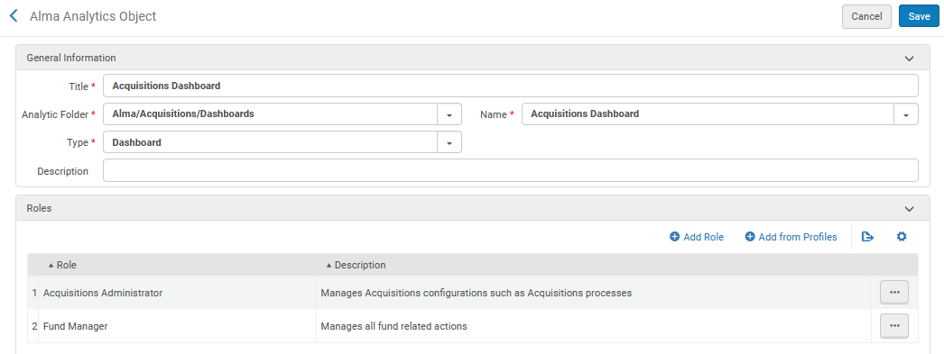
What is Alma Analytics? – role based
Alma Analytics may be accessed by staff users depending on roles
In order to be able to access the “Acquisitions Dashboard” the staff user must have either role “Acquisitions Administrator” or “Fund Manager”

Slide 24
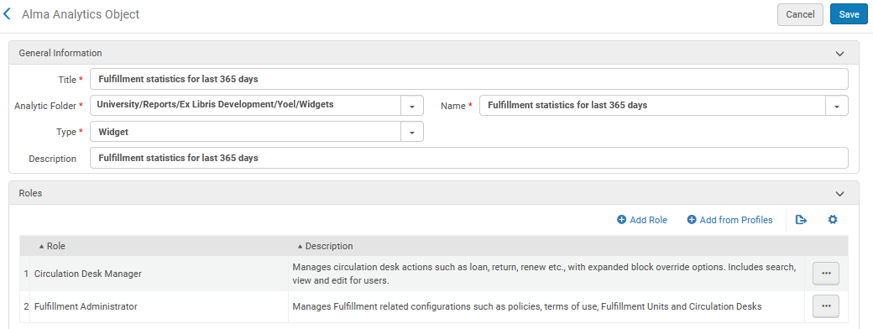
What is Alma Analytics? – role based
Alma Analytics may be accessed by staff users depending on roles
In order to be able to access the “Fulfillment statistics for last 365 days widget” the staff user must have either role “Circulation Desk manager” or “Fulfillment Administrator”

Slide 25
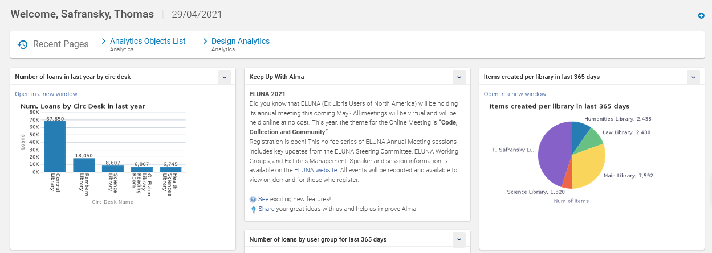
What is Alma Analytics? – role based
Alma landing page widgets

Slide 26
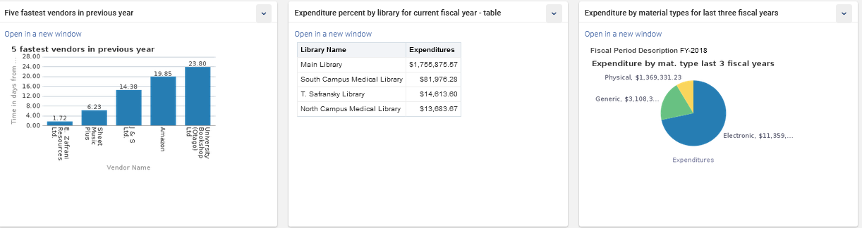
What is Alma Analytics? – role based
These are sample landing page widgets for an acquisitions librarian

Slide 27
xxx@exlibrisgroup.com

